Slide 1

COURSE TITLE: ENTREPRENEURSHIP & Technology Commercialization
Course Code: CS391
Course Instructor: Dr. Fahd S. Khan
Ghulam Ishaq Khan Institute Of Engineering Sciences and Technology

Slide 2
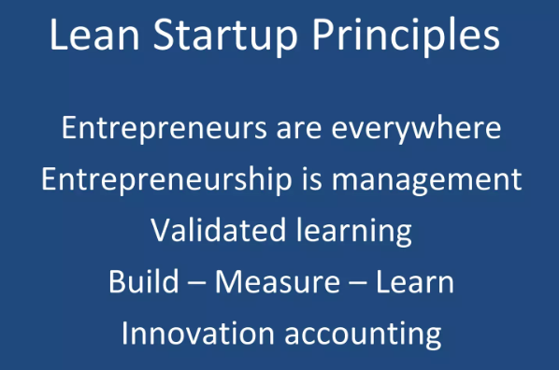

Slide 3
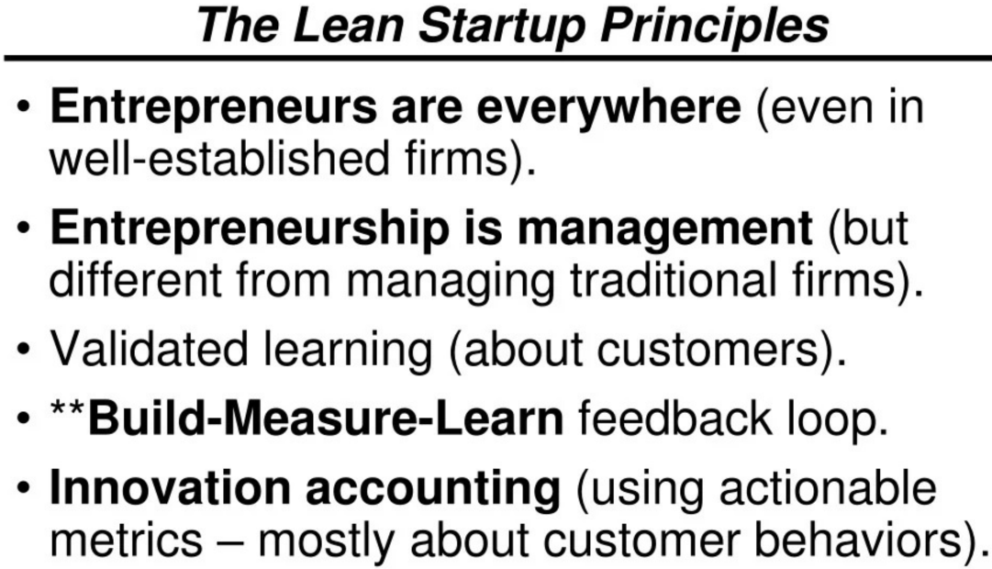

Slide 4
Is Lean Startup the right method for your business and what are the benefits?
It saves time: Short development cycles mean a quicker product-market fit. The product and its functions are optimized for the market.
It minimizes waste: The Lean Startup method streamlines business activities and allocates financial resources efficiently.
It reduces risk: By introducing a minimum viable product (MVP) to customers for feedback, companies can avoid high failure rates and reduce risk.
It’s a systematic approach: Lean Startup’s clearly defined process involves learning through feedback and improving through metrics-driven testing.
It provides a sustainable business model: One of the goals of Lean Startup is to develop a business model that guarantees sustainable growth and long-term competitiveness.

Slide 5
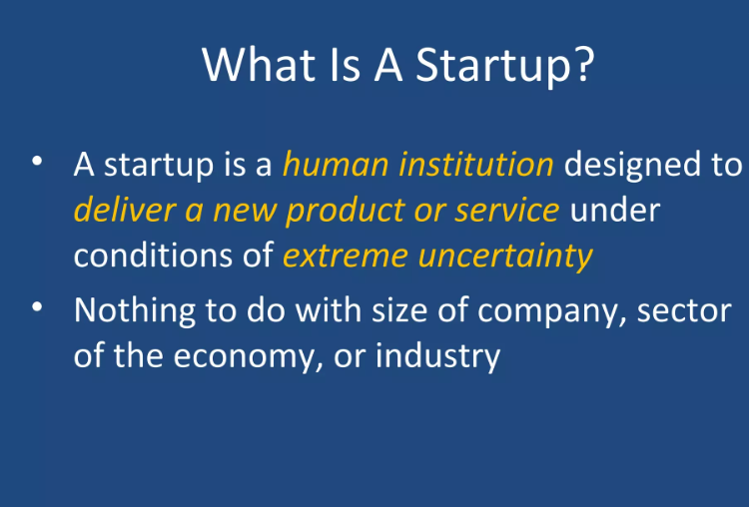

Slide 6
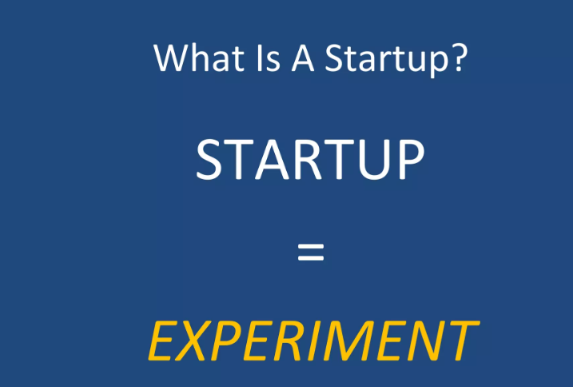

Slide 7
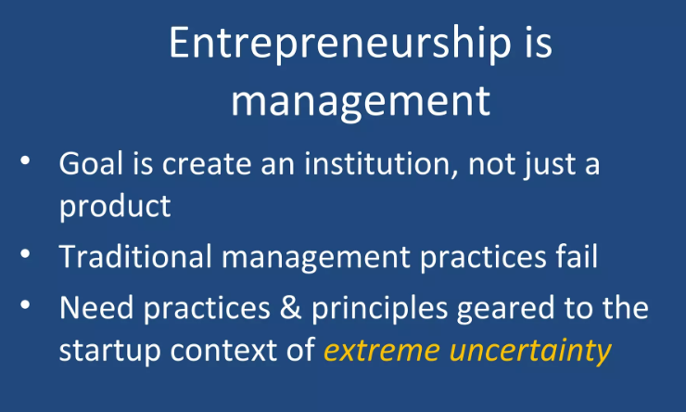

Slide 8
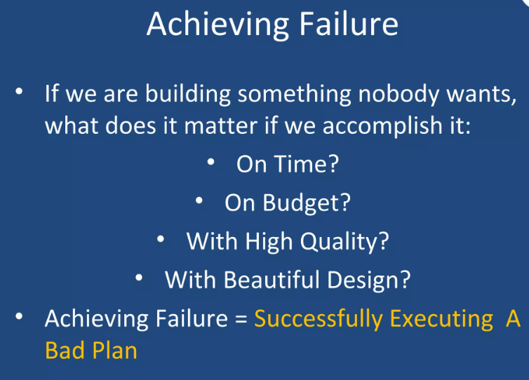

Slide 9
The Build-Measure-Learn feedback loop
BUILD
In the first phase of the cycle, everything revolves around the future product. It’ s not about producing a perfect product; the primary goal of this phase is to bring the product to market quickly and in doing so, minimize the process throughput time.
MEASURE
This is when customer feedback and reactions are collected. This data can be used to analyze and evaluate the product idea and its practical implementation. To keep this phase of the loop short, parameters for the data should be defined and set prior to market launch.
LEARN
The Learn phase is about validated learning. Assumptions about the product are checked against the collected data. The blind assumptions made at the beginning of the process are replaced by hypotheses. Two options:.Continue development or start from scratch.

Slide 10
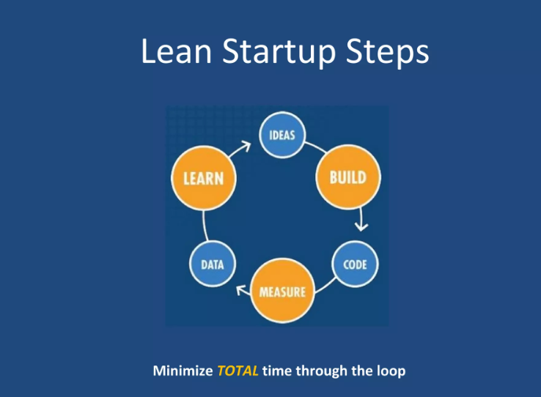

Slide 11
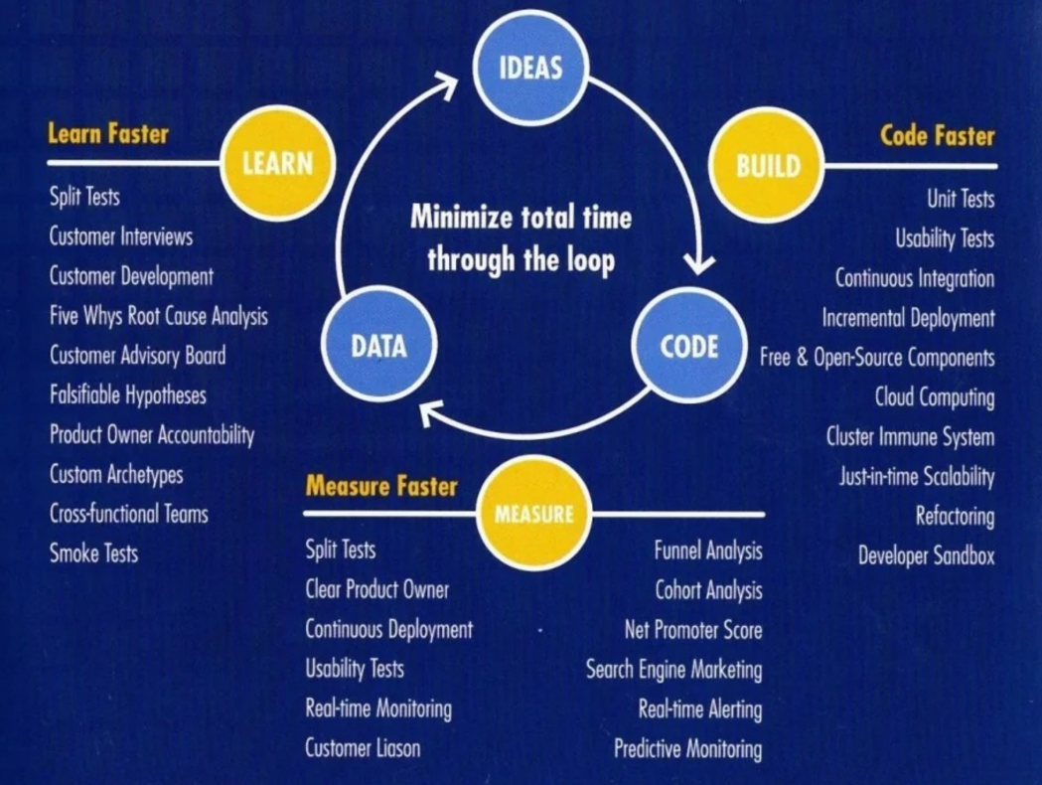

Slide 12
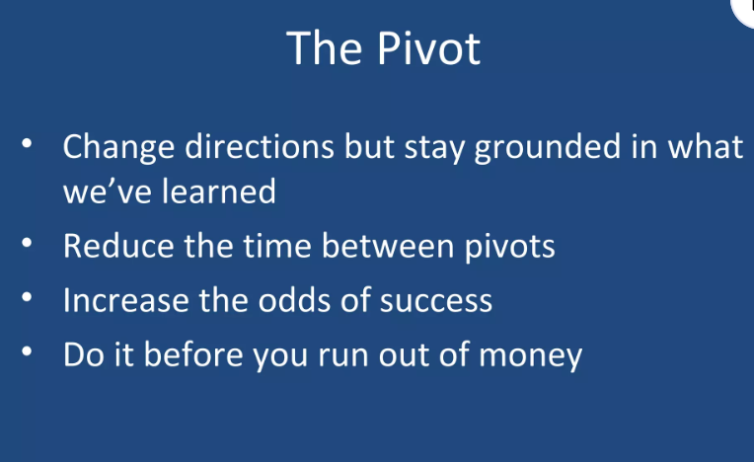

Slide 13
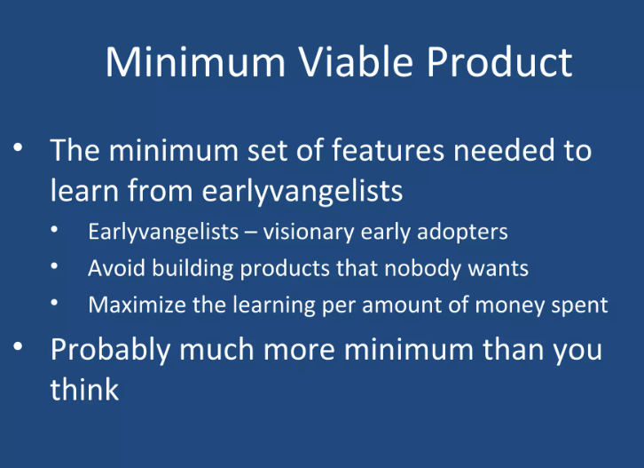

Slide 14
Gaining knowledge with the minimum viable product (MVP)
This means that the product should contain only a few basic functions. Before developing an MVP, the company needs to identify the most important problems of the customer group. Then a solution-oriented product can be developed. The MVP can be characterized as follows:
Minimum: The most stripped-down solution to the problem.
Viable: The solution provides enough features to satisfy early adopters.
Product: Something tangible that customers can touch and feel.
The core task of the MVP in Lean Startup is to generate maximum data to gain knowledge with minimal effort.

Slide 15
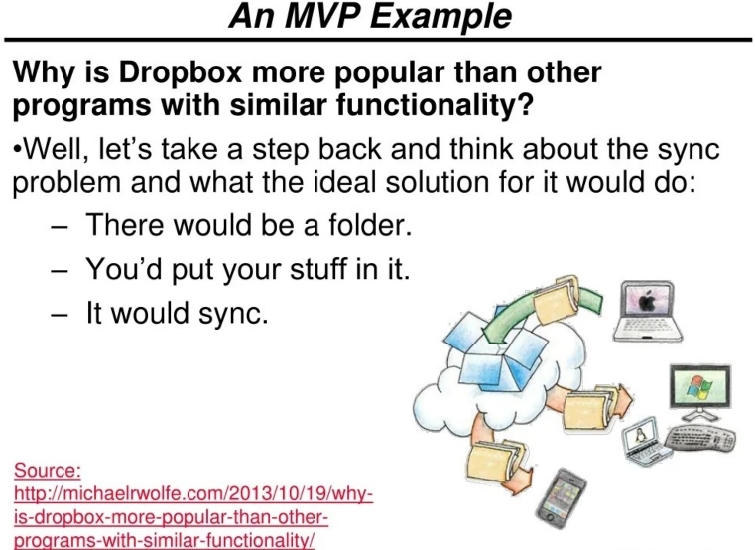

Slide 16
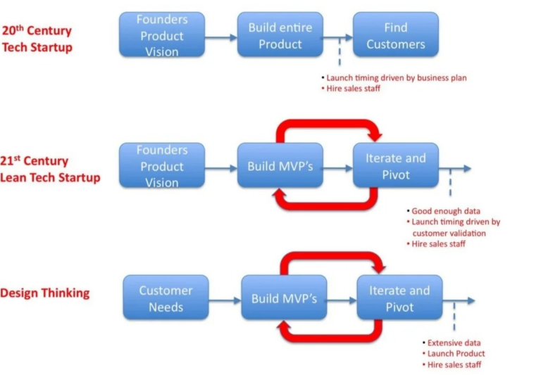

Slide 17
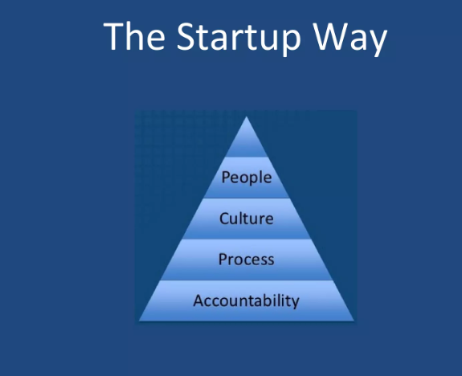

Slide 18
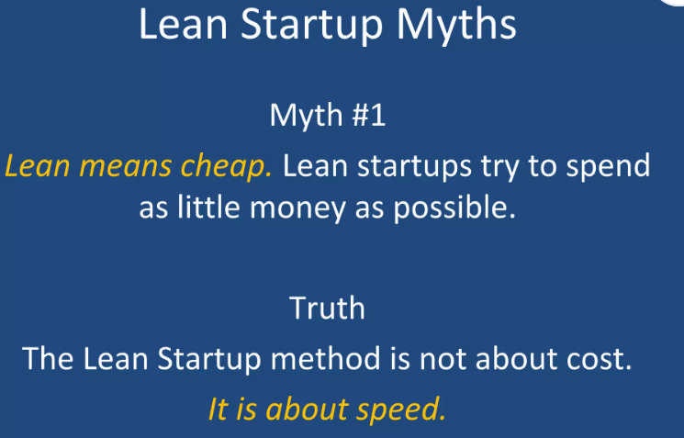

Slide 19
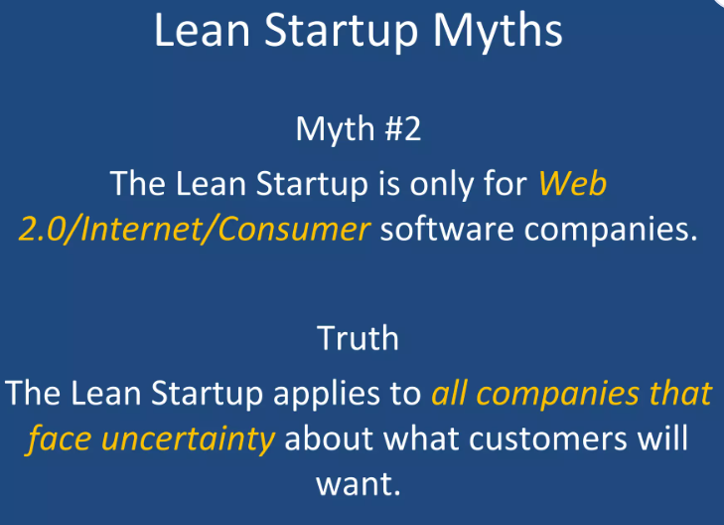

Slide 20
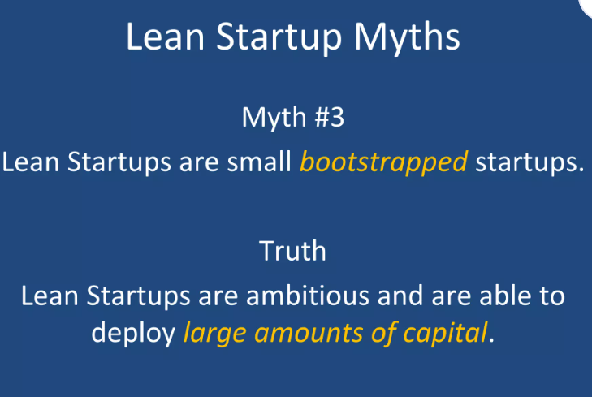

Slide 21
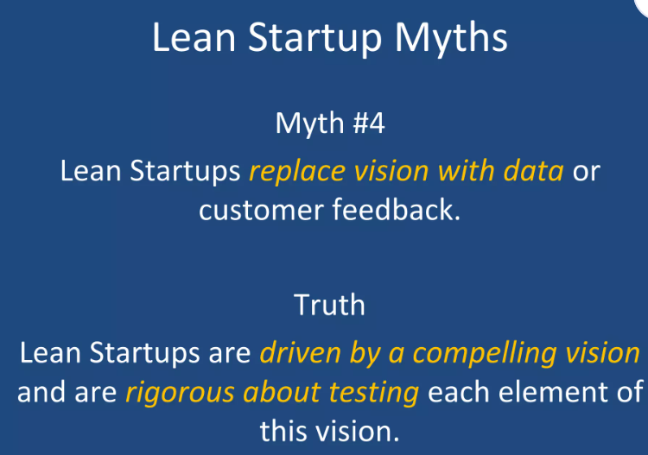

Slide 22
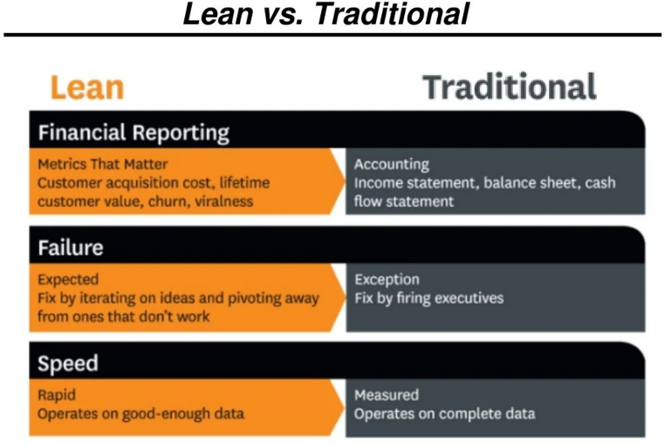

Slide 23
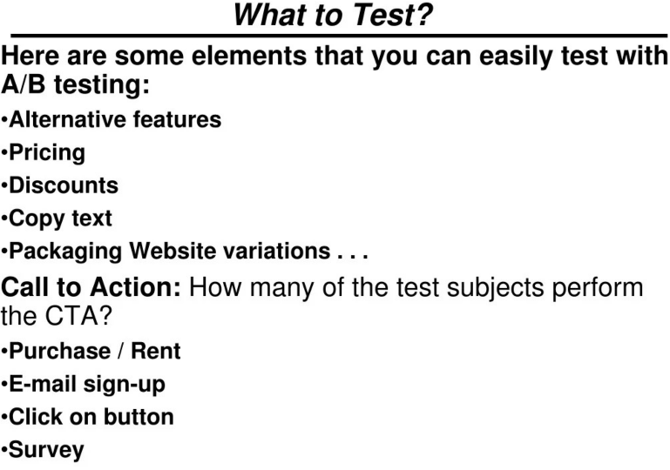

Slide 24
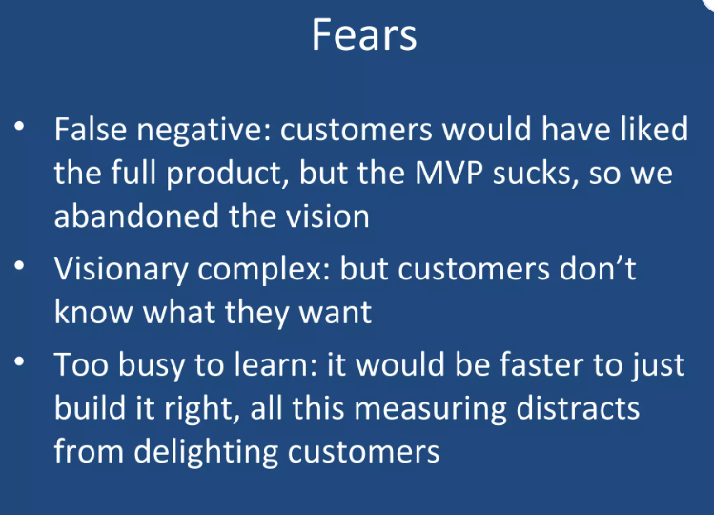

Slide 25
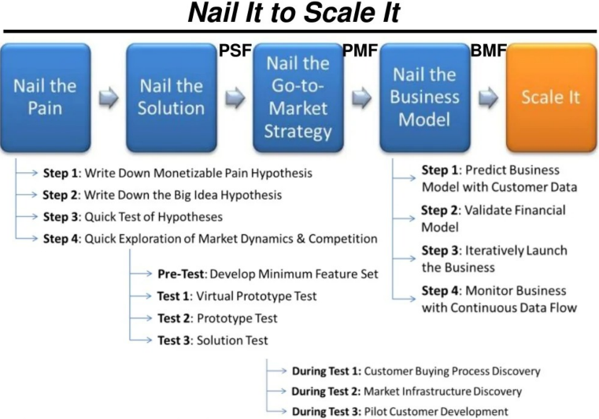

Slide 26


Slide 27
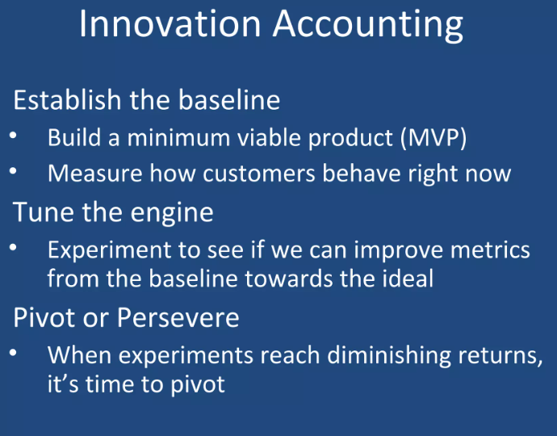

Slide 28
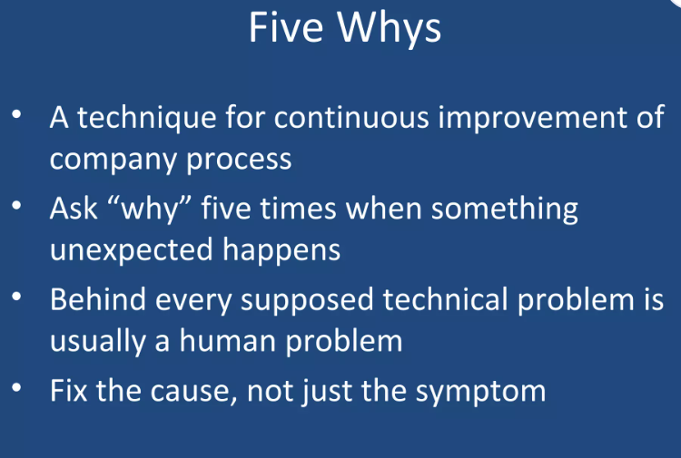

Slide 29
CLASS ACTIVITY
STEP 1:
Each team must brainstorm a simple digital product idea (e.g., a student-focused app, a campus service platform). Teams then identify one core problem for their target customer and formulate a Value Hypothesis and a Growth Hypothesis.
STEP 2:
The team must define the Minimum Viable Product (MVP). What are the minimum set of features needed to test the core value hypothesis? Sketch the single most important screen or feature of this MVP.
STEP 3:
Each team presents their MVP sketch and hypothesis to one other team (their earlyvangelists ) for 2 minutes. The receiving team gives 3 minutes of specific, actionable feedback. The presenting team must define one key metric (e.g., sign-up rate, feature usage) and explain how they'd measure it to validate their hypothesis (The AAA's of Metrics: Actionable, Accessible, Auditable).
STEP 4
They must write down a one-sentence justification for their decision and explain how they will implement the next cycle of the B-M-L loop.

